Slide 1
Data Structure
Sorted List (ADT)
Lecture-07

Slide 2
Object-oriented vs. Top Down
Object-oriented design
focuses on the data objects that are to be transformed
resulting in a hierarchy of objects
nouns are the primary focus
nouns in objects;
verbs become operations
Top-down design
focus on the process of transforming the input into the output,
resulting in a hierarchy of tasks
verbs are the primary focus
2

Slide 3
Sorted Type Class Interface Diagram
SortedType class
MakeEmpty
Private data:
length
info [ 0 ]
[ 1 ]
[ 2 ]
[MAX_ITEMS-1]
currentPos
IsFull
GetLength
GetItem
PutItem
DeleteItem
ResetList
GetNextItem
3

Slide 4
Member functions
Which member function specifications and implementations must change to ensure that any instance of the Sorted List ADT remains sorted at all times?
PutItem
DeleteItem
4

Slide 5
InsertItem algorithm for SortedList ADT
Find proper location for the new element in the sorted list.
Create space for the new element by moving down all the list elements that will follow it.
Put the new element in the list.
Increment length.
5

Slide 6
template<class ItemType>
class sortedtype
{
private:
int length;
ItemType info[MAX_ITEM];
int currentPos;
public:
sortedtype();
void MakeEmpty();
void InsertItem(ItemType);
void DeleteItem(ItemType);
bool isFull();
bool isEmpty();
int LengthIs();
void RetriveItem(ItemType&, bool&);
void ResetList();
void GetNextItem(ItemType&);
~sortedtype();
};

Slide 7
Constructor
template <class ItemType>
sortedtype<ItemType>::sortedtype()
{
length = 0;
currentPos = - 1;
}

Slide 8
template <class ItemType>
void sortedtype<ItemType>::MakeEmpty()
{
length=0;
}

Slide 9
template <class ItemType>
bool sortedtype<ItemType>::isFull()
{
return(length==MAX_ITEM);
}

Slide 10
template <class ItemType>
int sortedtype<ItemType>::LengthIs()
{
return length;
}

Slide 11
template <class ItemType>
void sortedtype<ItemType>::ResetList()
{
currentPos=-1;
}

Slide 12
template <class ItemType>
void sortedtype<ItemType>::GetNextItem(ItemType& item)
{
currentPos++;
item=info[currentPos];
}

Slide 13
template <class ItemType>
void sortedtype<ItemType>::InsertItem(ItemType item)
{
int location = 0;
bool moreToSearch = (location < length);
while (moreToSearch)
{
if(item > info[location])
{
location++;
moreToSearch = (location < length);
}
else (item < info[location])
moreToSearch = false;
}
for (int index = length; index > location; index--)
info[index] = info[index - 1];
info[location] = item;
length++;
}

Slide 14
template <class ItemType>
void sortedtype<ItemType>::DeleteItem(ItemType item)
{
int location = 0;
while (item != info[location])
location++;
for (int index = location + 1; index < length; index++)
info[index - 1] = info[index];
length--;
}

Slide 15
template <class ItemType>
void sortedtype<ItemType>::RetriveItem(ItemType& item, bool& found)
{
int midPoint, first = 0, last = length - 1;
bool moreToSearch = (first <= last);
found = false;
while (moreToSearch && !found)
{
midPoint = (first + last) / 2;
if(item < info[midPoint])
{
last = midPoint - 1;
moreToSearch = (first <= last);
}
else if(item > info[midPoint])
{
first = midPoint + 1;
moreToSearch = (first <= last);
}
else
{
found = true;
item = info[midPoint];
}
} }

Slide 16
DeleteItem algorithm for SortedList ADT
Find the location of the element to be deleted from the sorted list.
Eliminate space occupied by the item by moving up all the list elements that follow it.
Decrement length.
16

Slide 17
void SortedType :: DeleteItem ( ItemType item )
{
int location = 0;
// find location of element to be deleted
while ( item.ComparedTo ( info[location] )!= EQUAL )
location++;
// move up elements that follow deleted item in sorted list
for ( int index = location + 1 ; index < length; index++ )
info [ index - 1 ] = info [ index ];
length--;
}
17

Slide 18
Binary Seach in a Sorted List
Examines the element in the middle of the array.
Is it the sought item?
If so, stop searching.
Is the middle element too small?
Then start looking in second half of array.
Is the middle element too large?
Then begin looking in first half of the array.
Repeat the process in the half of the list that should be examined next.
Stop when item is found, or when there is nowhere else to look and item has not been found.
18

Slide 19
ItemType SortedType::GetItem ( ItemType item, bool& found )
// Pre: Key member of item is initialized.
// Post: If found, item’s key matches an element’s key in the list
// and a copy of that element is returned; otherwise,
// original item is returned.
{ int midPoint;
int first = 0;
int last = length - 1;
bool moreToSearch = ( first <= last );
found = false;
while ( moreToSearch && !found )
{ midPoint = ( first + last ) / 2 ; // INDEX OF MIDDLE ELEMENT
switch ( item.ComparedTo( info [ midPoint ] ) )
{
case LESS : . . . // LOOK IN FIRST HALF NEXT
case GREATER : . . . // LOOK IN SECOND HALF NEXT
case EQUAL : . . . // ITEM HAS BEEN FOUND
}
}
}
19

Slide 20
Trace of Binary Search
item = 45
15 26 38 57 62 78 84 91 108 119
info[0] [1] [2] [3] [4] [5] [6] [7] [8] [9]
first midPoint last
LESS last = midPoint - 1
15 26 38 57 62 78 84 91 108 119
info[0] [1] [2] [3] [4] [5] [6] [7] [8] [9]
first midPoint last
GREATER first = midPoint + 1
20

Slide 21
Trace continued
item = 45
15 26 38 57 62 78 84 91 108 119
info[0] [1] [2] [3] [4] [5] [6] [7] [8] [9]
first, last
midPoint
GREATER first = midPoint + 1
15 26 38 57 62 78 84 91 108 119
info[0] [1] [2] [3] [4] [5] [6] [7] [8] [9]
first,
midPoint,
last
LESS last = midPoint - 1
21

Slide 22
Trace concludes
item = 45
15 26 38 57 62 78 84 91 108 119
info[0] [1] [2] [3] [4] [5] [6] [7] [8] [9]
last first
first > last found = false
22

Slide 23
ItemType SortedType::GetItem ( ItemType item, bool& found )
// ASSUMES info ARRAY SORTED IN ASCENDING ORDER
{ int midPoint;
int first = 0;
int last = length - 1;
bool moreToSearch = ( first <= last );
found = false;
while ( moreToSearch && !found )
{ midPoint = ( first + last ) / 2 ;
switch ( item.ComparedTo( info [ midPoint ] ) )
{ case LESS : last = midPoint - 1;
moreToSearch = ( first <= last );
break;
case GREATER : first = midPoint + 1;
moreToSearch = ( first <= last );
break;
case EQUAL : found = true ;
item = info[ midPoint ];
break;
}
}return item;
}
23

Slide 24
Allocation of memory
STATIC
ALLOCATION
Static allocation is the allocation of memory space at compile time.
DYNAMIC
ALLOCATION
Dynamic allocation is the allocation of memory space at run time by using operator new.
24

Slide 25
3 Kinds of Program Data
STATIC DATA: memory allocation exists throughout execution of program.
static long SeedValue;
AUTOMATIC DATA: automatically created at function entry, resides in activation frame of the function, and is destroyed when returning from function.
DYNAMIC DATA: explicitly allocated and deallocated during program execution by C++ instructions written by programmer using unary operators new and delete
25

Slide 26
Arrays created at run time
If memory is available in an area called the free store (or heap), operator new allocates memory for the object or array and returns the address of (pointer to) the memory allocated.
Otherwise, the NULL pointer 0 is returned.
The dynamically allocated object exists until the delete operator destroys it.
26

Slide 27
Dynamic Array Allocation
char *ptr; // ptr is a pointer variable that
// can hold the address of a char
ptr = new char[ 5 ];
// dynamically, during run time, allocates
// memory for 5 characters and places into // the contents of ptr their beginning address
6000
6000
ptr
27

Slide 28
Dynamic Array Allocation
char *ptr ;
ptr = new char[ 5 ];
strcpy( ptr, “Bye” );
ptr[ 1 ] = ‘u’; // a pointer can be subscripted
std::cout << ptr[ 2] ;
6000
6000
‘u’
‘B’ ‘y’ ‘e’ ‘\0’
ptr
28

Slide 29
class SortedType<char>
SortedType
Private data:
length 3
listData
currentPos ?
MakeEmpty
~SortedType
‘C’ ‘L’ ‘X’
RetrieveItem
InsertItem
DeleteItem
.
.
.
GetNextItem
29
Notes:
29

Slide 30
InsertItem algorithm for Sorted Linked List
Find proper position for the new element in the sorted list using two pointers predLoc and location, where predLoc trails behind location.
Obtain a node for insertion and place item in it.
Insert the node by adjusting pointers.
Increment length.
30

Slide 31
Why is a destructor needed?
When a local list variable goes out of scope, the memory space for data member listPtr is deallocated.
But the nodes to which listPtr points are not deallocated.
A class destructor is used to deallocate the dynamic memory pointed to by the data member.
31
Notes:
31

Slide 32
Implementing the Destructor
SortedType::~SortedType()
// Post: List is empty; all items have
// been deallocated.
{
NodeType* tempPtr;
while (listData != NULL)
{
tempPtr = listData;
listData = listData->next;
delete tempPtr;
}
}
32

Slide 33
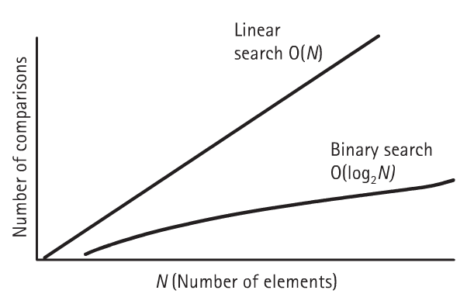
How do the SortedList implementations compare?
33

Slide 34




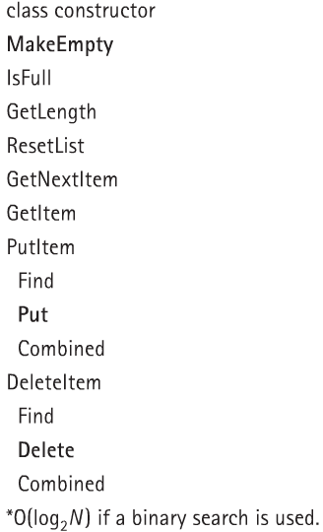
SortedList implementations comparison
34

Slide 35
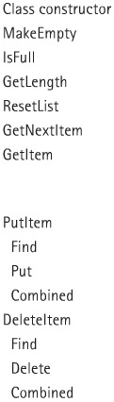


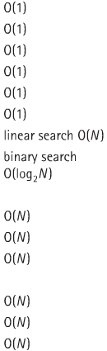

List implementations comparison

